Slide 1
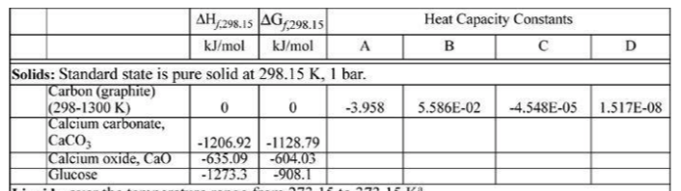
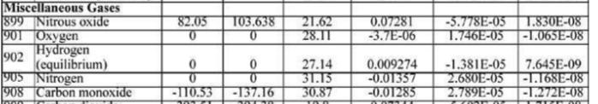
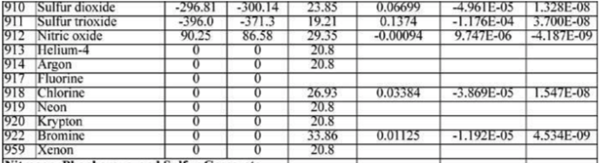
Dependencies of the Heat of Formation
Reference State: Elemental ground state at STP has an enthalpy of formation of 0 N₂, O₂, He etc.
Generally, energy is released on formation of a molecule from the elements if the molecule is stable, so the heat of formation is generally negative. For unstable molecules such as NO which is a radical formed at high temperatures, the heat of formation is positive (endothermic).

Slide 2
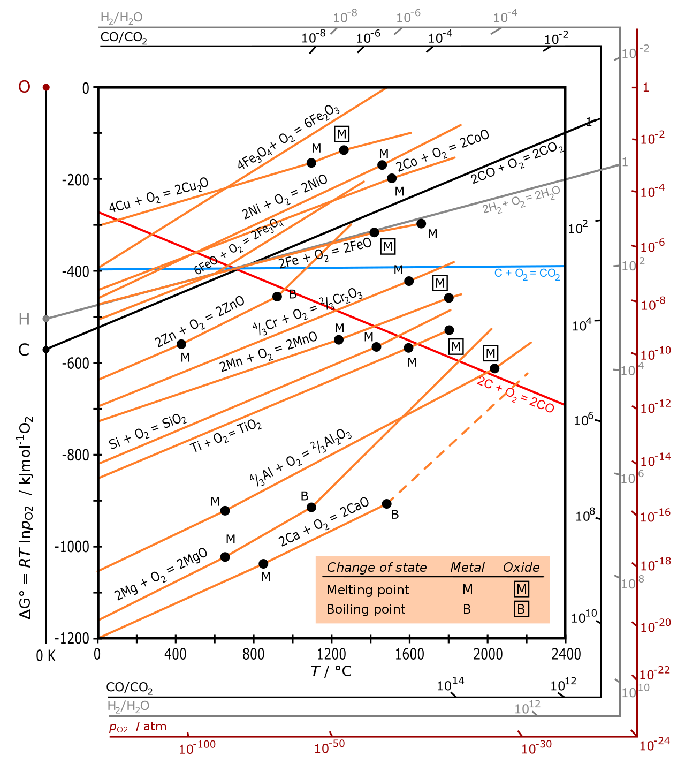
Ellingham Diagrams

Slide 3
Ellingham Diagrams
For a reaction
ΔG = ΔH – T ΔS
Gas has more entropy
than solid
ΔH positive, ΔS negative if moles of gas decrease
A line in ΔG vs T plot with positive slope
Reactions that increase the moles of gas have negative slope
No change in moles of gas a flat slope

Slide 4
p_{O2} is 1 atm
Reactions with one mole of O₂
Determine the relative ease of reducing a given metallic oxide to metal
Determine the partial pressure of oxygen that is in equilibrium with a metal oxide at a given temperature
Determine the ratio of carbon monoxide to carbon dioxide that will be able to reduce the oxide to metal at a given temperature.
Ellingham Diagrams

Slide 5
Ease of Reduction
Top are most easily reduced
If the curve is below, it will drive the higher curve to reduction (reverse)
High temperatures are needed to reduce iron oxide with carbon (coke)
Magnesothermal reduction, use magnesium metal to reduce titania or silica to titanium metal or silica metal
Ellingham Diagrams

Slide 6
2. Equilibrium O₂ Partial Pressure
Red P_{O2} scale
Partial pressure of 10⁻²⁰ atm of O₂
Above will oxidize aluminum at 1600°C below will reduce
Ellingham Diagrams

Slide 7
3. Ratio of CO/CO₂ Needed for Reduction with Carbon
To reduce an oxide, you need a minimum CO/CO₂ ratio
To reduce Al at 1600°C you need a CO/CO₂ ratio greater than 5x10⁷
Ellingham Diagrams

Slide 8
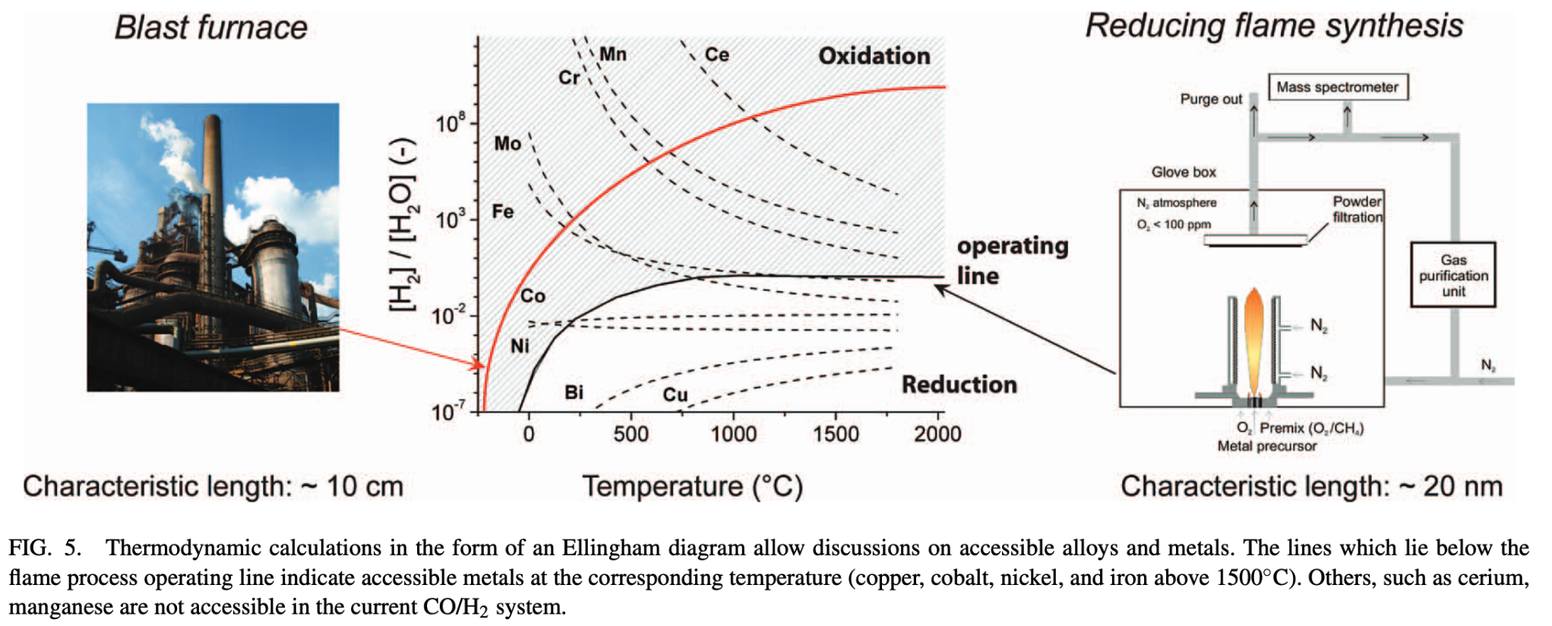
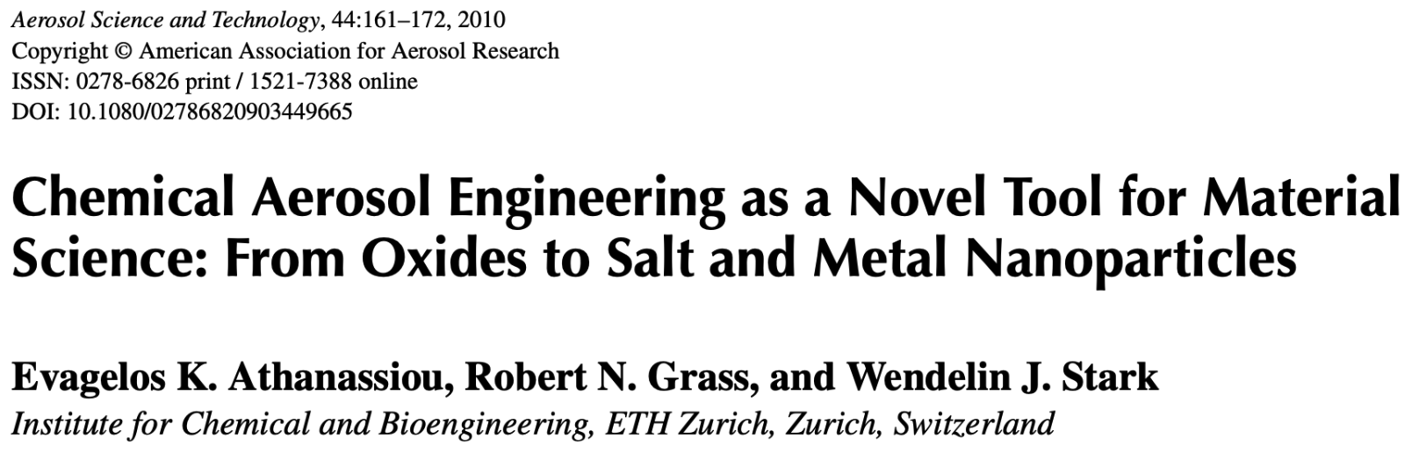
Ellingham Diagrams

Slide 9
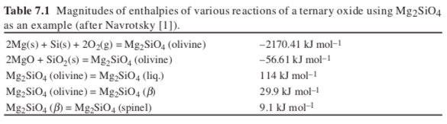
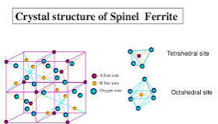
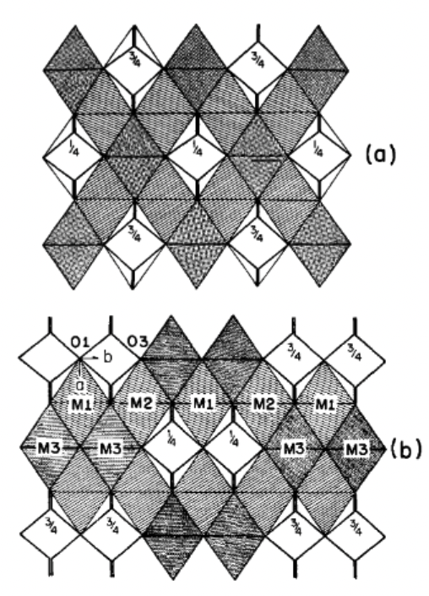
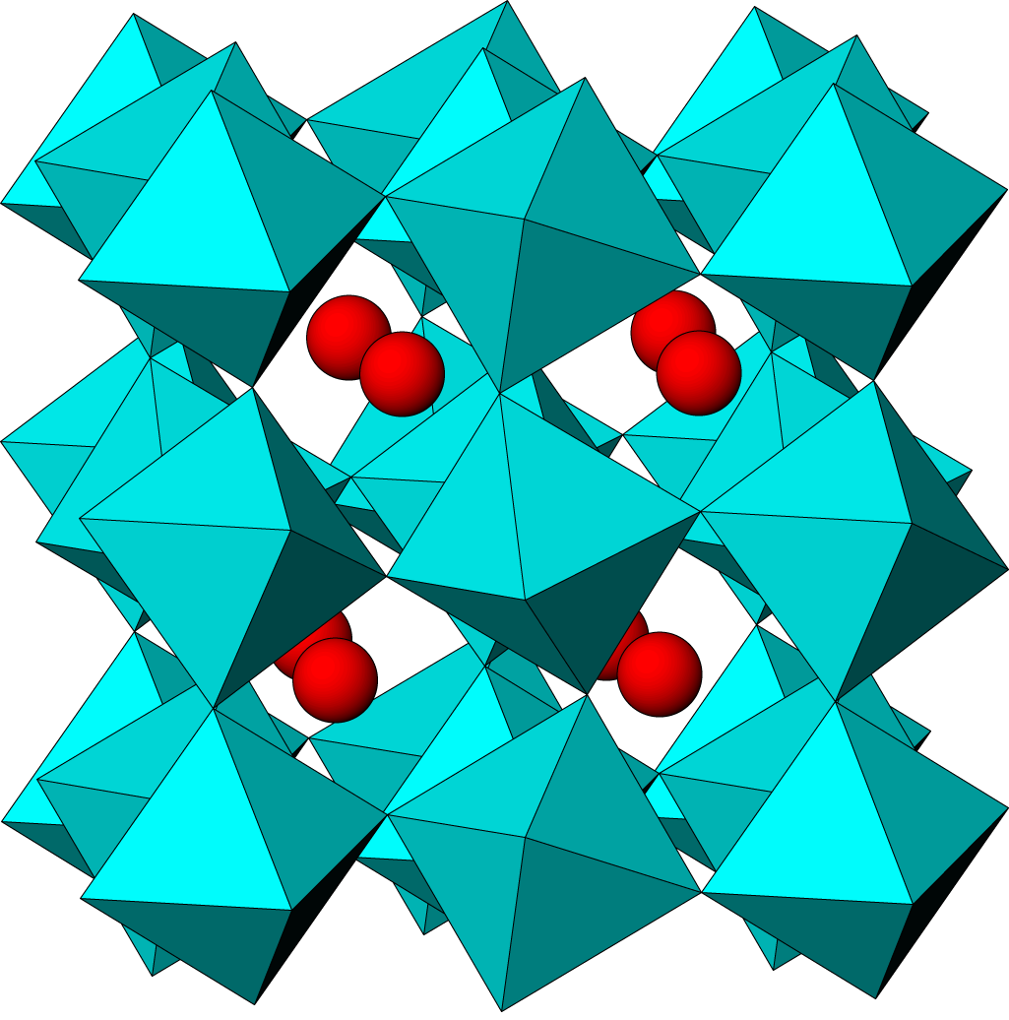
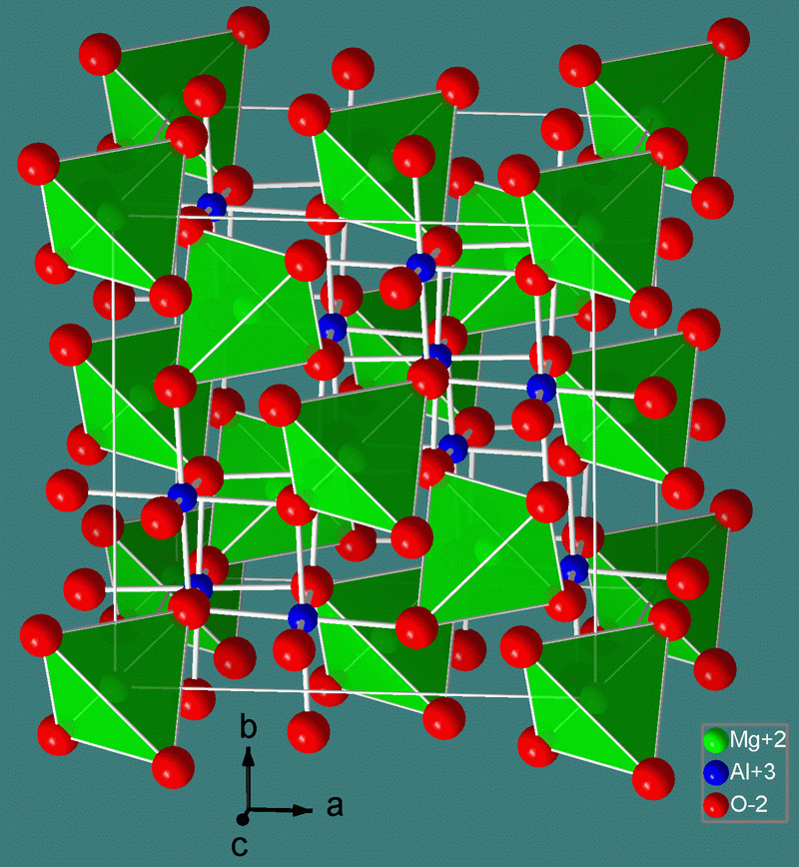
Relative magnitude of heat of formation from elements, oxides, heat of fusion, heat of transition
Olivine
Spinel
Spinel
β

Slide 10
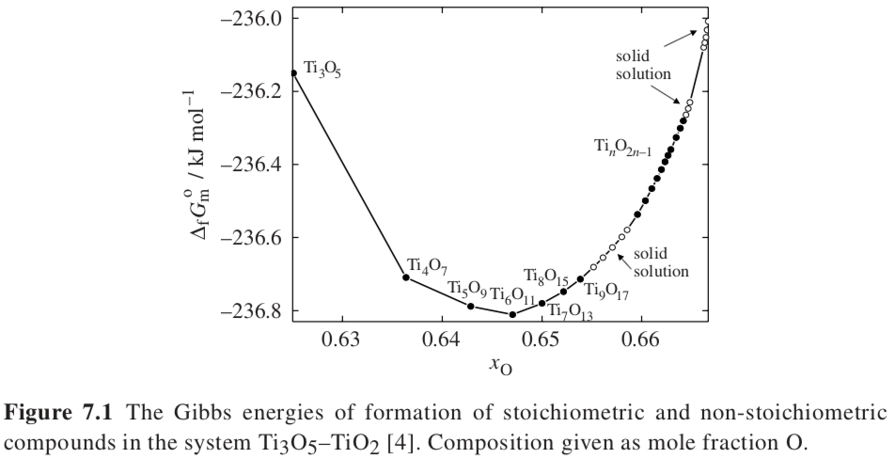
Heats of formation for various titanium oxides
Values are almost identical

Slide 11
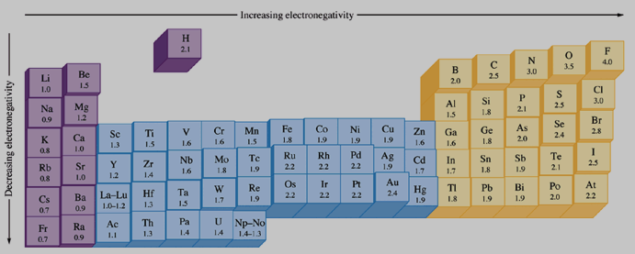
Electronegativity, the ability of an atom to attract electrons in a bond
Linus Pauling

Slide 12
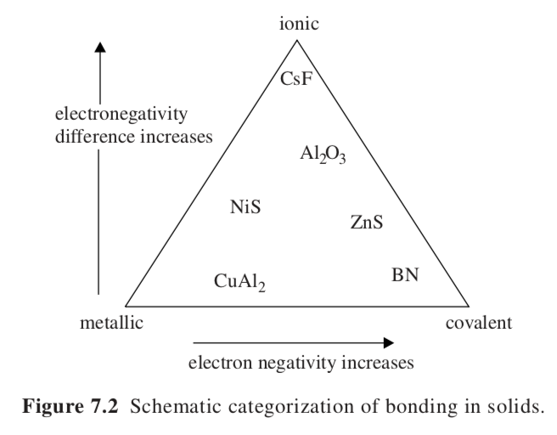
Factors involved in the heat of formation: electronegativity and atomic size
Van Arkel–Ketelaar triangle
Jensen’s quantitative triangle
Norman’s quantitative triangle
Difference in electronegativity between the two compounds on y-axis
Average electronegativity of the two compounds on x-axis

Slide 13
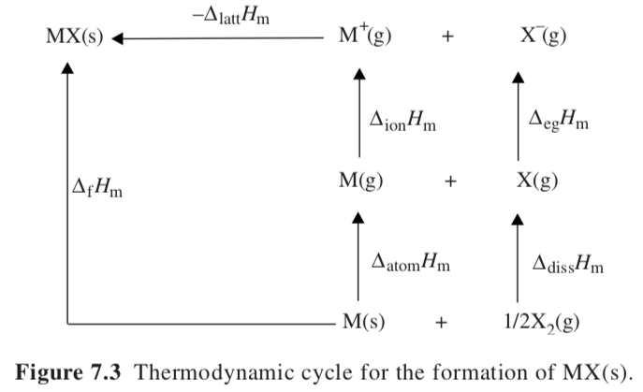

Hess’s Law
Energetics of compound formation
“Electron gain”
e.g. molten Na and Cl₂ gas

Slide 14
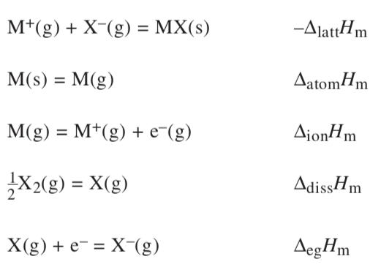
Energetics of compound formation

Slide 15

Energetics of compound formation
Electrostatic attraction +-
Electron electron repulsion
Van der Waals or dispersion (d+ makes d- leads to net attraction)
Polarization (shifting within compound of electrons)
Crystal field effects

Slide 16


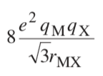
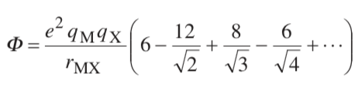
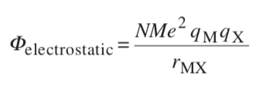

Electrostatic interactions in NaCl
Nearest neighbors of Na⁺ and Cl₋
Repulsive cationic terms, second nearest neighbors
Third nearest neighbors, attraction between M⁺ and X⁻
Generally:

Slide 17


Repulsion and Dispersion Terms
Leonard-Jones (6-12) Potential
12 is repulsive since dE/dr = F is positive (guessed)
6 is van der Waals attractive force (calculated)
Buckingham Potential
Exponential term works better for ceramics

Slide 18
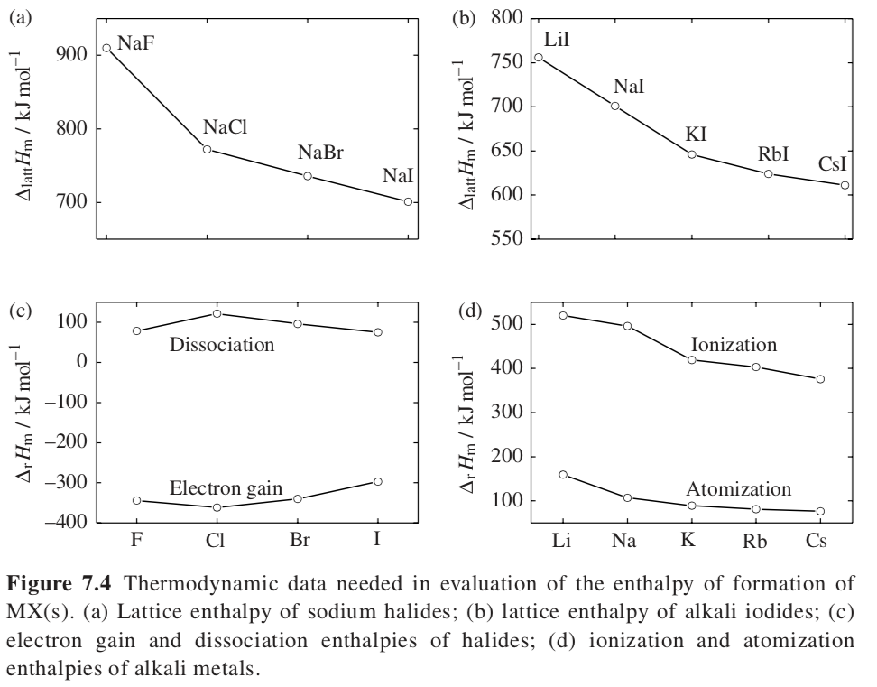
Less electroneg. Alkalies
Less stable
Less electroneg. Halides
Less stable
Polarization
Lattice
Lattice
Less electroneg. Alkalies
More stable

Slide 19
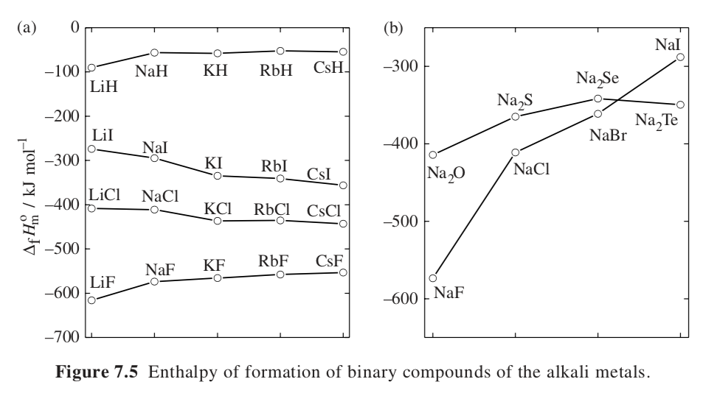
Trends in Enthalpy of Formation Alkali Metals
Less electroneg. alkalies
Electroneg. Halide big impact
Lattice cancels atomization and ionization
ΔH_{lattice} drops others constant across halides Fig. 7.4 a c

Slide 20
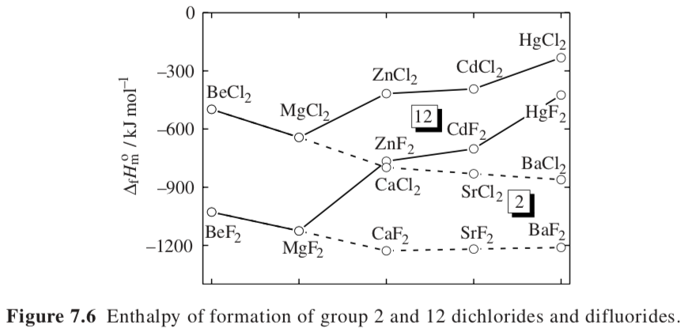
“Extra electrons (12) are not screening the nuclear charge effectively, resulting in a much higher ionization enthalpy for the group 12 elements and a less negative enthalpy of formation for the group 12 compounds compared with the group 2 compounds.” (book)

Slide 21
Transition Metal Enthalpy of Formation
Crystal Field Theory (CFT):
This theory explains how the arrangement of ligands around a central metal ion splits the d orbitals into different energy levels, depending on the geometry of the complex.

Slide 22
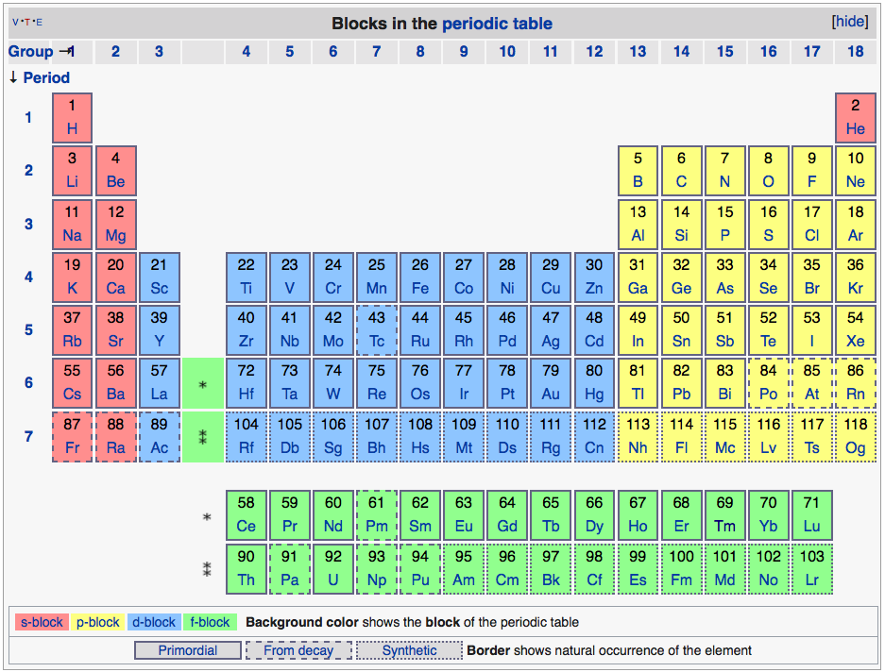
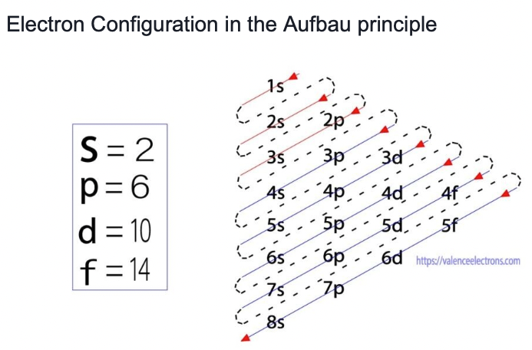
d-orbitals
10 valence electrons
Transition
Metals
Acidic (at high oxidation state)
Acidic
Basic
Basic (at low oxidation state)
s-orbitals
2 valence electrons
(more basic to right)
p-orbitals
6 valence electrons
(more acidic to right)
f-orbitals
14 valence electrons

Slide 23
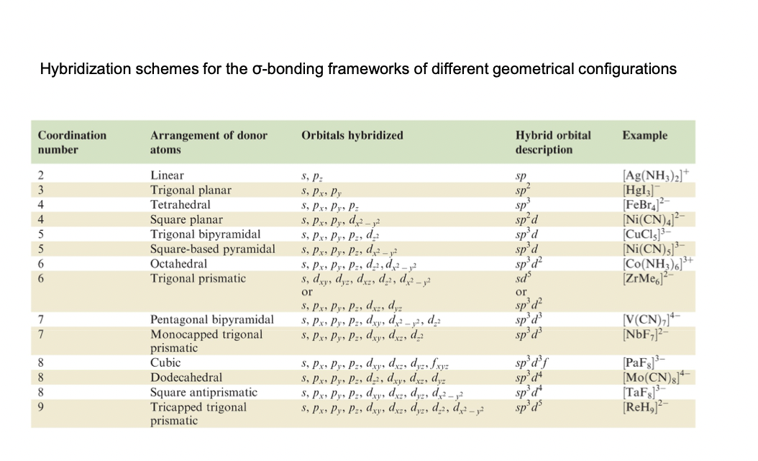
f-orbitals
14 valence electrons

Slide 24
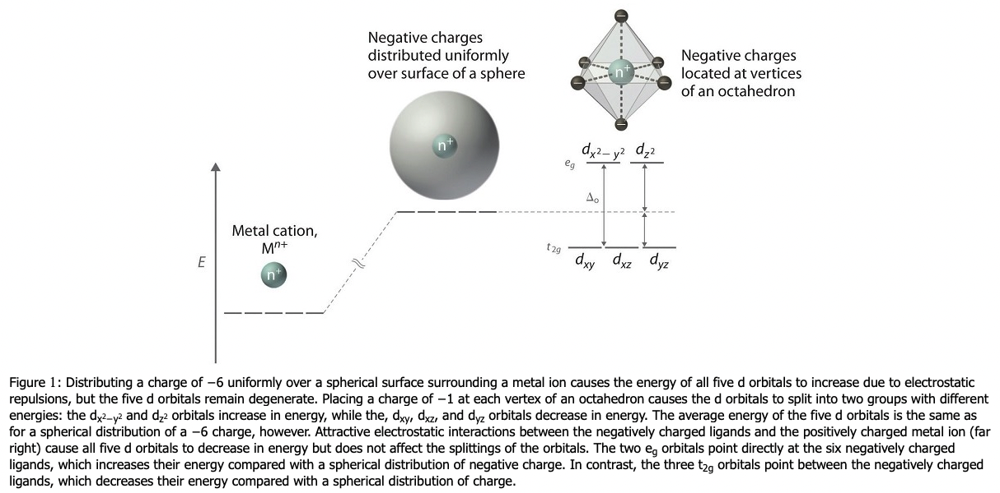


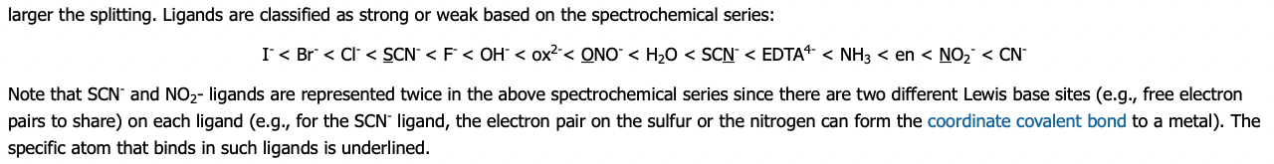
Depending on the crystallographic environment the d-orbital energies split
This impacts the Enthalpy of Formation
https://chem.libretexts.org/Bookshelves/Inorganic_Chemistry/Supplemental_Modules_and_Websites_(Inorganic_Chemistry)/Crystal_Field_Theory/Crystal_Field_Theory
Crystal Field Theory

Slide 25
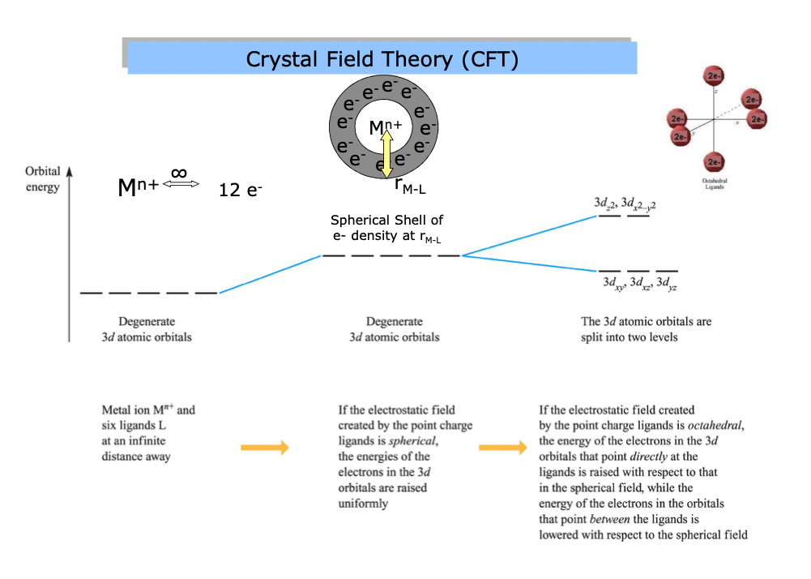
Depending on the crystallographic environment the d-orbital energies split
This impacts the Enthalpy of Formation
https://chem.libretexts.org/Bookshelves/Inorganic_Chemistry/Supplemental_Modules_and_Websites_(Inorganic_Chemistry)/Crystal_Field_Theory/Crystal_Field_Theory

Slide 26
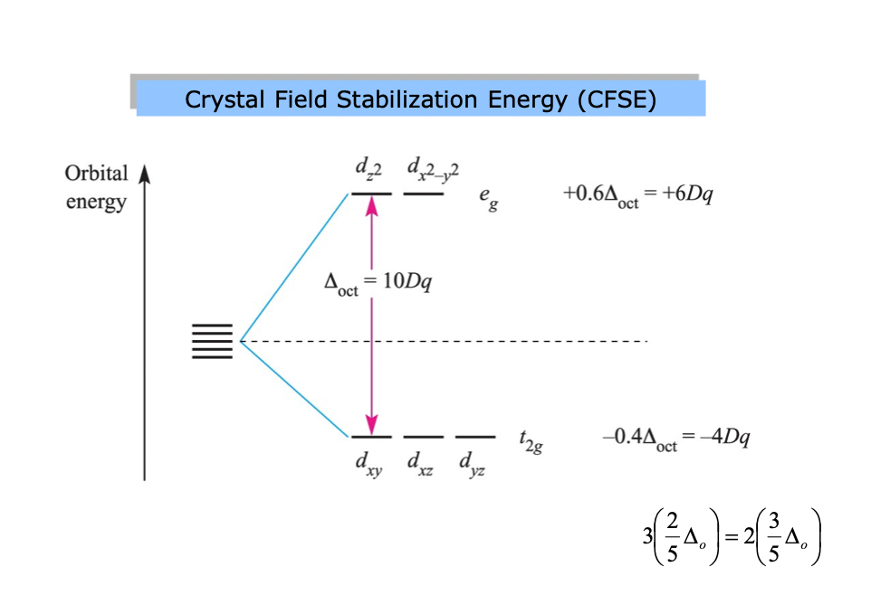
Depending on the crystallographic environment the d-orbital energies split
This impacts the Enthalpy of Formation
https://chem.libretexts.org/Bookshelves/Inorganic_Chemistry/Supplemental_Modules_and_Websites_(Inorganic_Chemistry)/Crystal_Field_Theory/Crystal_Field_Theory

Slide 27
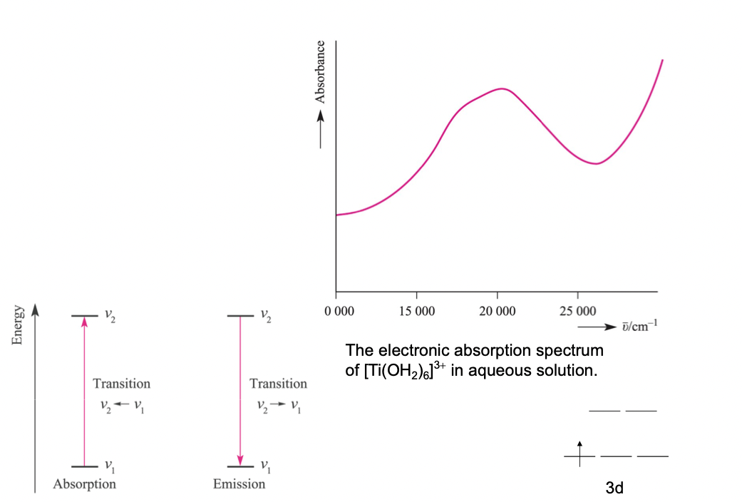
Depending on the crystallographic environment the d-orbital energies split
This impacts the Enthalpy of Formation
https://chem.libretexts.org/Bookshelves/Inorganic_Chemistry/Supplemental_Modules_and_Websites_(Inorganic_Chemistry)/Crystal_Field_Theory/Crystal_Field_Theory

Slide 28
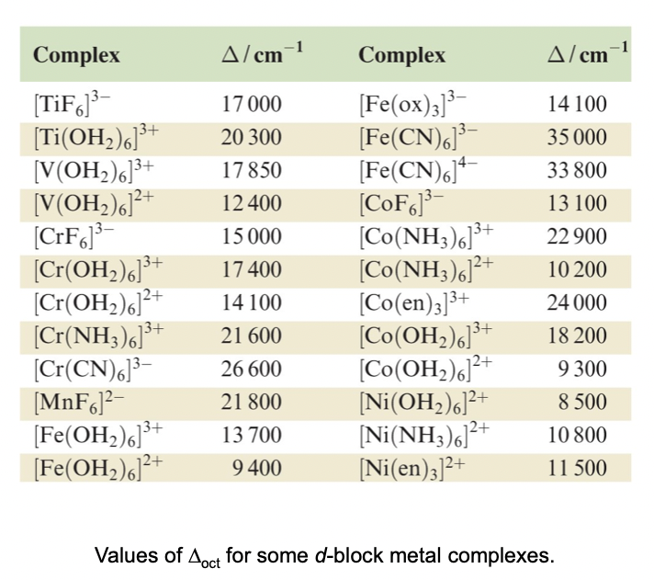
Depending on the crystallographic environment the d-orbital energies split
This impacts the Enthalpy of Formation
https://chem.libretexts.org/Bookshelves/Inorganic_Chemistry/Supplemental_Modules_and_Websites_(Inorganic_Chemistry)/Crystal_Field_Theory/Crystal_Field_Theory

Slide 29
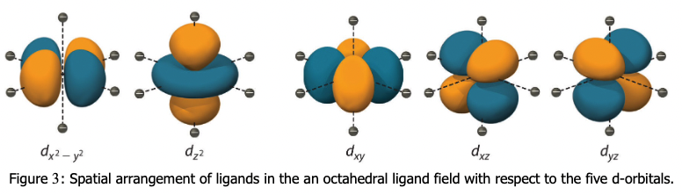
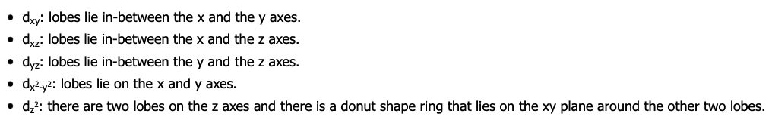
Depending on the crystallographic environment the d-orbital energies split
This impacts the Enthalpy of Formation
https://chem.libretexts.org/Bookshelves/Inorganic_Chemistry/Supplemental_Modules_and_Websites_(Inorganic_Chemistry)/Crystal_Field_Theory/Crystal_Field_Theory

Slide 30
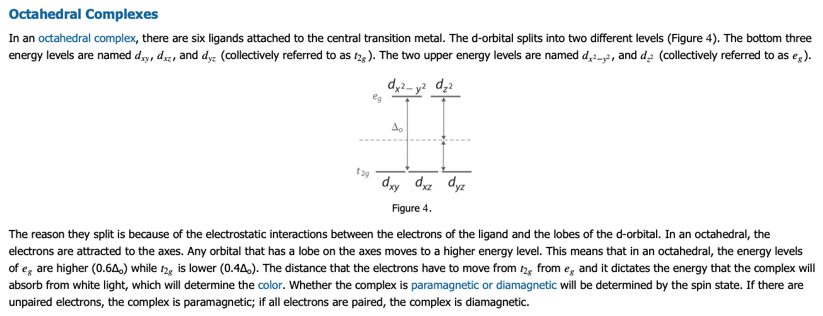
Depending on the crystallographic environment the d-orbital energies split
This impacts the Enthalpy of Formation
https://chem.libretexts.org/Bookshelves/Inorganic_Chemistry/Supplemental_Modules_and_Websites_(Inorganic_Chemistry)/Crystal_Field_Theory/Crystal_Field_Theory

Slide 31
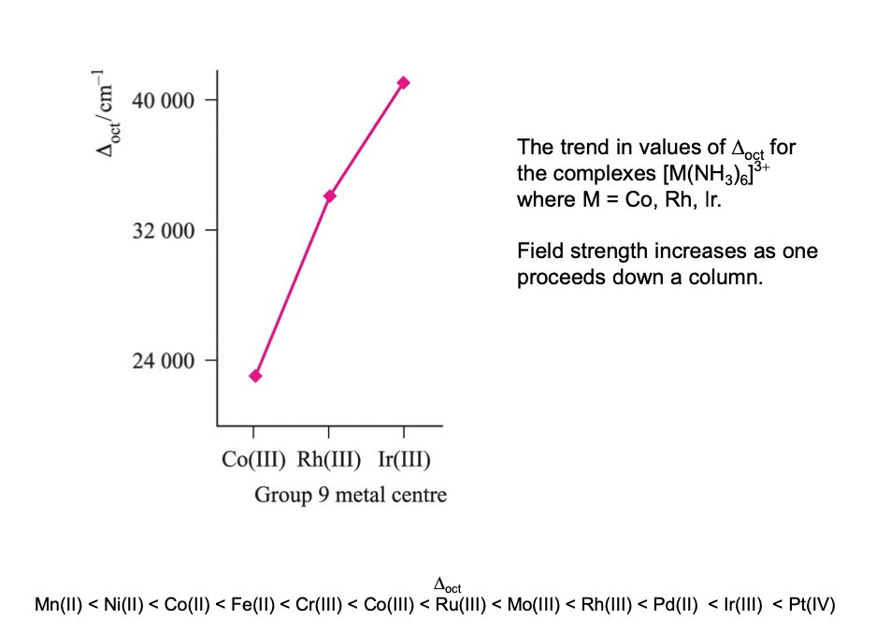
Depending on the crystallographic environment the d-orbital energies split
This impacts the Enthalpy of Formation
https://chem.libretexts.org/Bookshelves/Inorganic_Chemistry/Supplemental_Modules_and_Websites_(Inorganic_Chemistry)/Crystal_Field_Theory/Crystal_Field_Theory

Slide 32
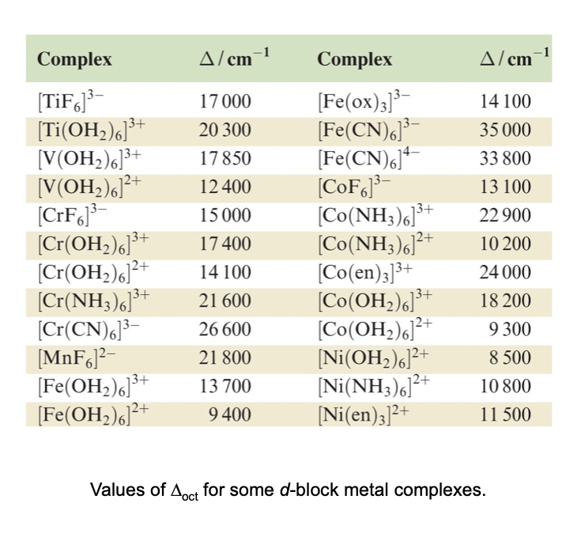
Depending on the crystallographic environment the d-orbital energies split
This impacts the Enthalpy of Formation
https://chem.libretexts.org/Bookshelves/Inorganic_Chemistry/Supplemental_Modules_and_Websites_(Inorganic_Chemistry)/Crystal_Field_Theory/Crystal_Field_Theory

Slide 33
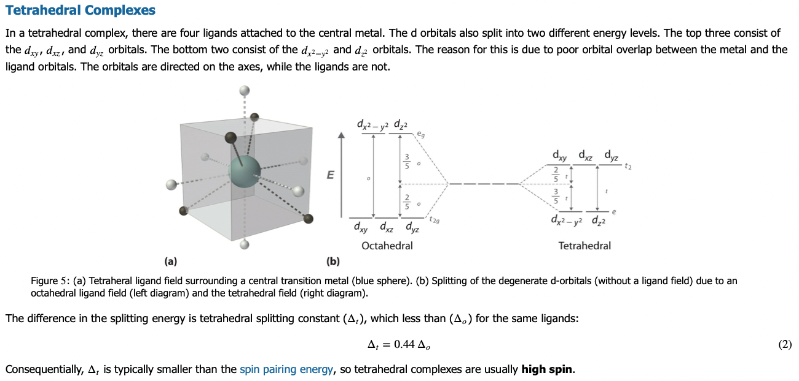
Depending on the crystallographic environment the d-orbital energies split
This impacts the Enthalpy of Formation
https://chem.libretexts.org/Bookshelves/Inorganic_Chemistry/Supplemental_Modules_and_Websites_(Inorganic_Chemistry)/Crystal_Field_Theory/Crystal_Field_Theory

Slide 34
Depending on the crystallographic environment the d-orbital energies split
This impacts the Enthalpy of Formation
https://chem.libretexts.org/Bookshelves/Inorganic_Chemistry/Supplemental_Modules_and_Websites_(Inorganic_Chemistry)/Crystal_Field_Theory/Crystal_Field_Theory
Spin Pairing Energy
The energy needed to pair two electrons in the same orbital, overcoming the natural tendency for electrons to occupy different orbitals with parallel spins (Hund's rule).
Impact on complex behavior:
When considering transition metal complexes, the relative magnitude of the spin pairing energy compared to the crystal field splitting energy determines whether a complex will be "high spin" (with many unpaired electrons) or "low spin" (with more paired electrons).
Paramagnetism and diamagnetism:
If a complex has unpaired electrons (high spin), it will be paramagnetic, meaning it will be attracted to a magnetic field; if all electrons are paired (low spin), it will be diamagnetic, repelled by a magnetic field.

Slide 35
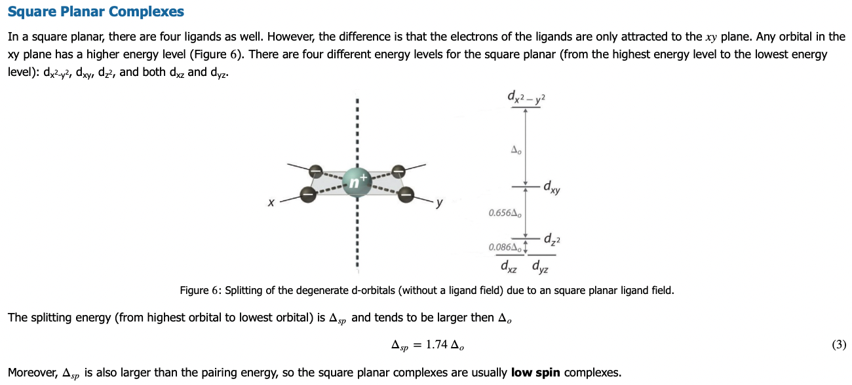
Depending on the crystallographic environment the d-orbital energies split
This impacts the Enthalpy of Formation
https://chem.libretexts.org/Bookshelves/Inorganic_Chemistry/Supplemental_Modules_and_Websites_(Inorganic_Chemistry)/Crystal_Field_Theory/Crystal_Field_Theory

Slide 36
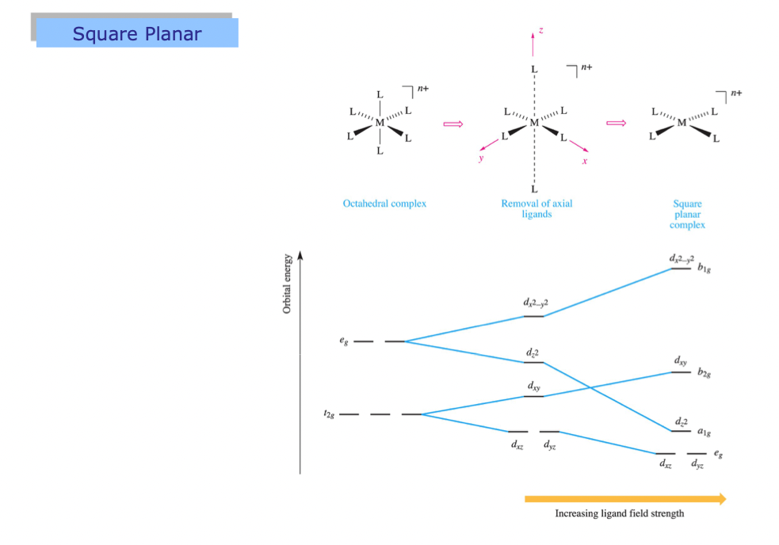
Depending on the crystallographic environment the d-orbital energies split
This impacts the Enthalpy of Formation
https://chem.libretexts.org/Bookshelves/Inorganic_Chemistry/Supplemental_Modules_and_Websites_(Inorganic_Chemistry)/Crystal_Field_Theory/Crystal_Field_Theory

Slide 37
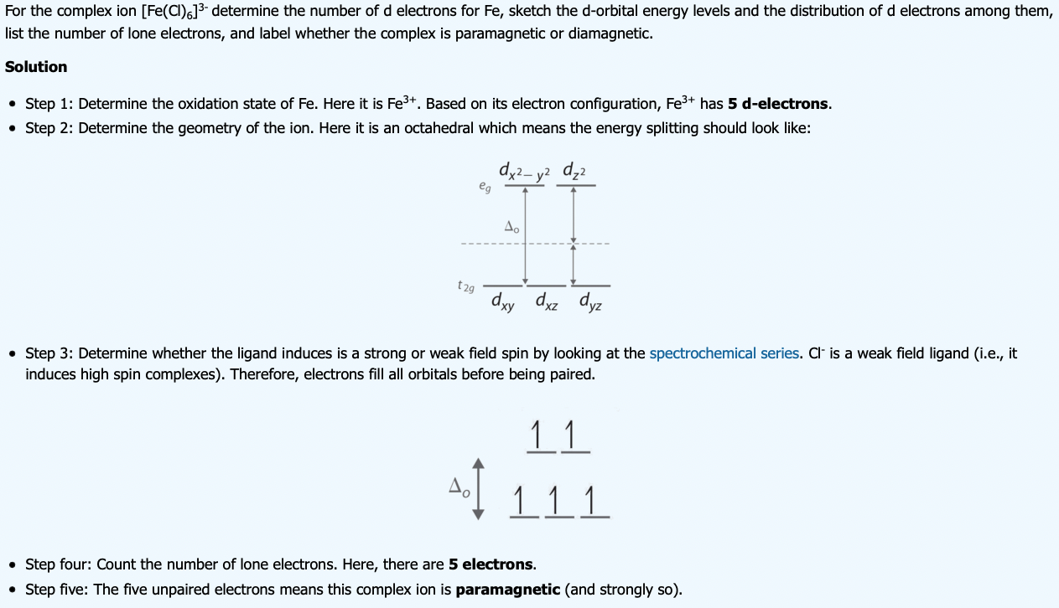
Depending on the crystallographic environment the d-orbital energies split
This impacts the Enthalpy of Formation
https://chem.libretexts.org/Bookshelves/Inorganic_Chemistry/Supplemental_Modules_and_Websites_(Inorganic_Chemistry)/Crystal_Field_Theory/Crystal_Field_Theory
26-3 = 23 = 2+2+6+2+6+(5 d). Unpaired electrons => Paramagnetic

Slide 38
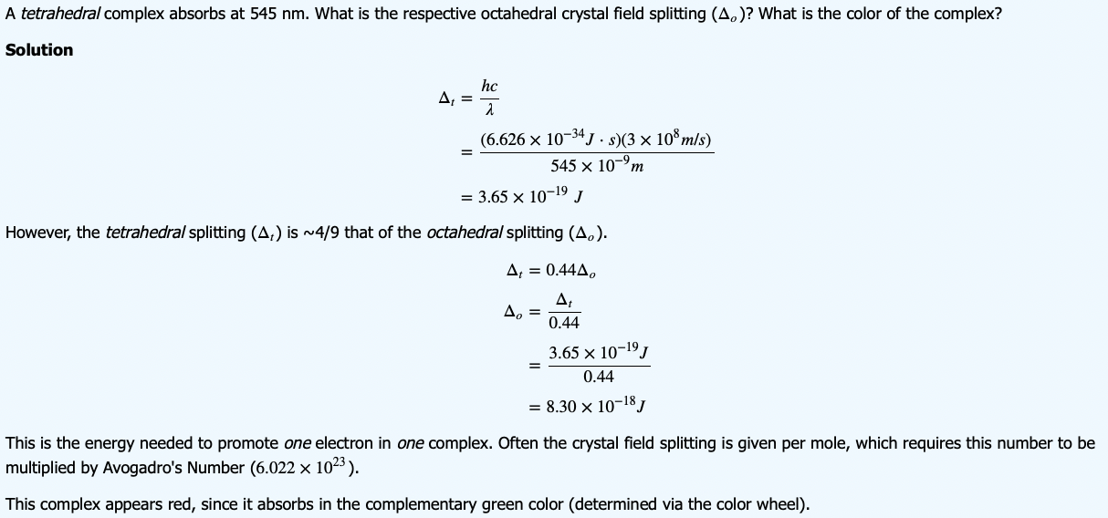
Depending on the crystallographic environment the d-orbital energies split
This impacts the Enthalpy of Formation
https://chem.libretexts.org/Bookshelves/Inorganic_Chemistry/Supplemental_Modules_and_Websites_(Inorganic_Chemistry)/Crystal_Field_Theory/Crystal_Field_Theory

Slide 39
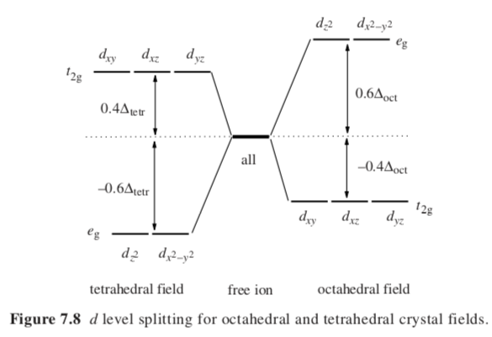
Depending on the crystallographic environment the d-orbital energies split
This impacts the Enthalpy of Formation
Crystal Field Effect

Slide 40
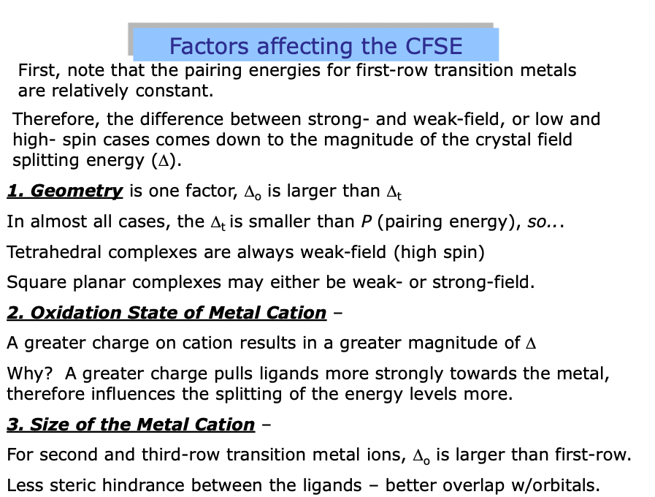
Crystal Field Stabilization Energy

Slide 41
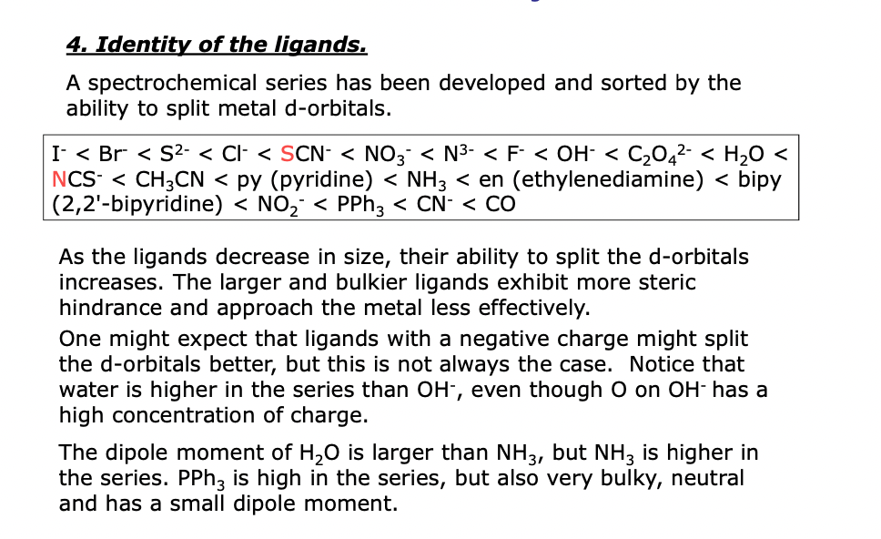
Crystal Field Stabilization Energy

Slide 42
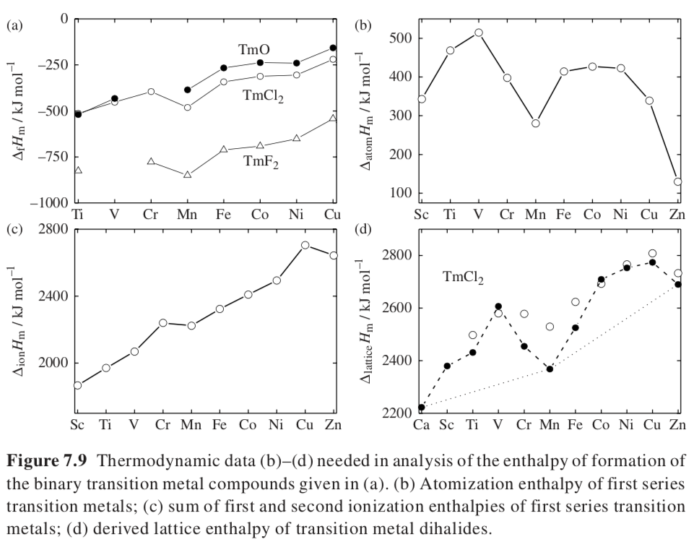
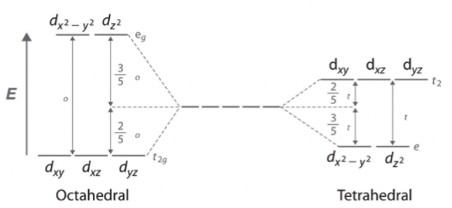
Transition metal lattice stabilization due to d-orbital splitting
First series chlorides, oxides and fluorides
Increasing d electrons
Atomization Component
Crystal Field Stabilization due to d-orbital splitting
(not for Ca, Mn, Zn)
Ionization Component
Lattice Component

Slide 43
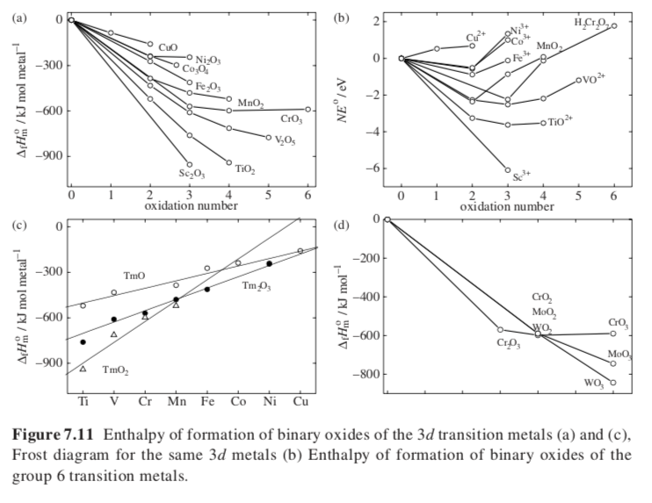

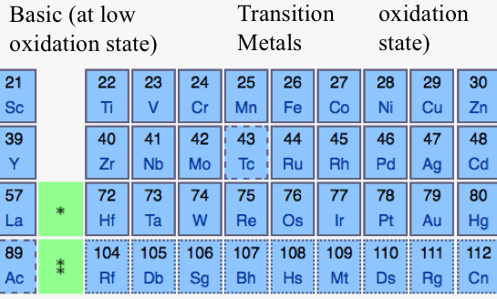
Heat of Formation for Transition Metal Oxides
in Different Oxidation States
Cr, Mo, W
3d, 4d, 5d

Slide 44

Acid-Base Model for Heat of Formation of Ternary Oxides
Na₂O
SiO₂
SiNa₂O₃
Base transfers its oxygen
s-block oxides
Acid accepts oxygen p-block oxides
Basicity
Acidity
MgO < CaO < SrO < BaO
Al < Si < P < S
SiO₄²⁻

Slide 45
d-orbitals
10 valence electrons
Transition
Metals
Acidic (at high oxidation state)
Acidic
Basic
Basic (at low oxidation state)
s-orbitals
2 valence electrons
(more basic to right)
p-orbitals
6 valence electrons
(more acidic to right)
f-orbitals
14 valence electrons

Slide 46
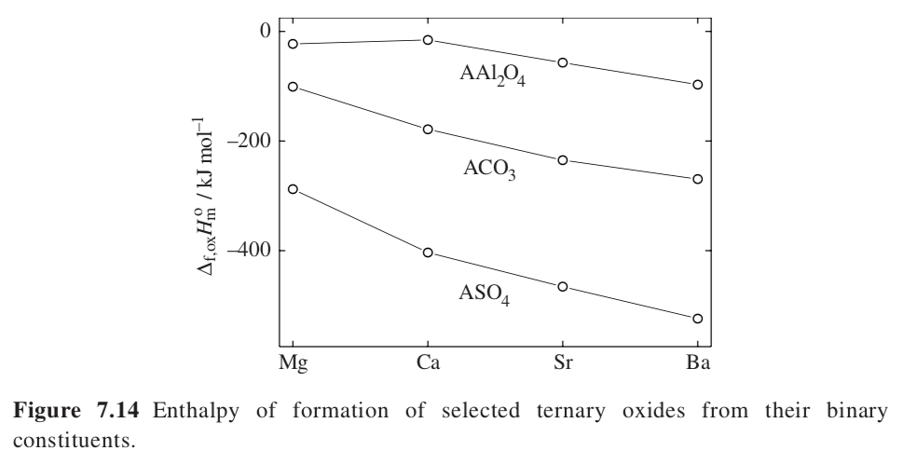
Most Basic Oxide
BaO
Sulfate most stable since SO3 most acidic

Slide 47
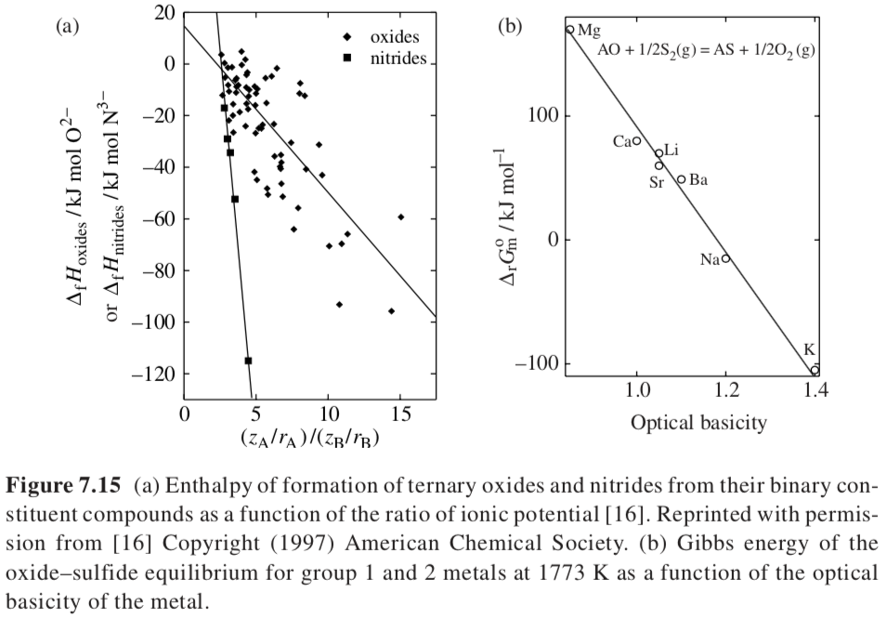
Ionic potential
e⁻/ionic radius (Å)
q/r
<2 strong base
2-4 basic
4-7 amphoteric
>7 acidic
Ionic potential ratio
From UV spectra of probe ion

Slide 48
Atomic Size
Perovskite structure
Calcium titanate CaTiO₃
Embed cations in the structure for engineered properties
One is solar energy absorption in Graetzel cells
These are the most promising low-temperature formation PV devices
(silicon solar cells require high temperature reduction of silica and chemical purification)
Cubic/Orthorhombic-like structure
Can accommodate many transition metals
ABX₃
A is much larger than B cations, X is anion (oxide)
B has 6-fold coordination surrounded by octahedron of anions
A has 12-fold cubahedral coordination
Red O²⁻
Blue Ti⁴⁺
Green Ca²⁺ or Ba²⁺

Slide 49


A is simple cubic
With O in the face center positions
And B in the body center positions
t = 1 Perfect Cubic
0.8 < t < 1.1

Slide 50


Slide 51
Methyl Ammonium Lead Halide

Slide 52
Schematic of a sensitized perovskite solar cell in which the active layer consist of a layer of mesoporous TiO₂which is coated with the perovskite absorber. The active layer is contacted with an n-type material for electron extraction and a p-type material for hole extraction. b) Schematic of a thin-film perovskite solar cell. In this architecture in which just a flat layer of perovskite is sandwiched between two selective contacts. c) Charge generation and extraction in the sensitized architecture. After light absorption in the perovskite absorber the photogenerated electron is injected into the mesoporous TiO₂ through which it is extracted. The concomitantly generated hole is transferred to the p-type material. d) Charge generation and extraction in the thin-film architecture. After light absorption both charge generation as well as charge extraction occurs in the perovskite layer.

Slide 53
spiro Ometad p-type semi-conductor

Slide 54

Enthalpy of Formation versus Number of Valence Electrons
Reduced electrons in bonding state
Increased electrons in anti-bonding state
TiC with ne = 4 has a high enthalpy of formation since the Fermi level falls in a pronounced gap in density of electronic states separating bonding and anti-bonding electron bands.
Fermi level falls in gap between bonding and anti-bonding at 4

Slide 55
Zeolites (Natural are aluminosilicate rocks, synthetic can be a variety of materials often based on SiO₂)
Microscopic structure of a zeolite (mordenite) framework, assembled from tetrahedra. Sodium is present as an extra-framework cation (in green).
Can form meso or micro pores (colloidal- or nano-scale) (These are terms from gas adsorption field.)

Slide 56


Reference 29
Synthetic Zeolites can have meso (colloidal) or micro (nano) pores depending on the templating material and synthesis conditions. Usually start with TEOS and a surfactant or block copolymer

Slide 57

Surface effect as we saw earlier except that this is on a molecular/nano scale
Enthalpy relative to quartz
Molar Volume

Slide 58

Energy of Formation for Substitutional Solid Solutions
Atomic Radii => Volume of compounds
Hume-Rothery Rule limited solubility if size difference exceeds 15%
Electronegativity
Large difference in binary system leads to negative enthalpy of mixing Pd-Zr and is
small for systems with low or no electronegativity and size difference Ti-Zr
Valence electron density
Binary components have the same crystal structure
Large enthalpy of mixing is related to large number of intermetallic phases
Elastic contribution to the enthalpy of mixing, small mixes well with large
c_{i} are constants x_{i} mole fractions V molar volumes
Sub-regular solution model

Slide 59


Slide 60



Energy of Formation for Interstitial Solid Solutions
Elastic interactions
Electronic interactions
Gas solubility in metals
Temperature
Pressure solubility for H₂ x ~ √p
Sievert’s Law
Solubility of gasses in metals

Slide 61

6 kJ/mole difference in formation enthalpy
Reduction temperature is 600K higher for hexagonal
Cubic reduced SrMnO_{2.5} is more stable
Octahedral corners shared in cubic, faces shared in hexagonal
High vacancies in faces make reduced hexagonal unfavorable

Slide 62

Liquid-Liquid Miscibility
Mixing of acidic (SiO₂) and Basic (CaO) oxides Si⁴⁺ has coordination number 4 and Ca²⁺ has 6
SiO₂ mixes well with CaO but CaO has a harder time mixing with SiO₂
ZrF₄ strong acid
Increasing basicity
Increasing basicity
Ortho-silicate
Ca₂SiO₄
ZrF₆²⁻

Slide 63
Liquid Salt Mixtures
Size parameter, d = (d_{A} – d_{B})/(d_{A} + d_{B})
Common Anions mix with negative enthalpy of mixing
Common cations do not mix due to anion-anion repulsion

Slide 64



Conformational Enthalpy of Polymers
The Rotational Isomeric State Model of Volkenstein and Paul Flory (Nobel Prize)
Carbon has a tetrahedral bonding arrangement
For a chain of carbon, the two side groups interact with the side groups of neighboring carbons
For Butene
“Trans” is sterically the most favorable arrangement
“Gauche +” and “Gauche -” are less favorable
The Boltzmann equation gives the probability of a particular conformation, Z is the partition function or the sum of all the different Boltzmann expressions in an ensemble

Slide 65
Conformational Enthalpy of Polymers
The Rotational Isomeric State Model of Volkenstein and Paul Flory (Nobel Prize)
Carbon has a tetrahedral bonding arrangement
For a chain of carbon, the two side groups interact with the side groups of neighboring carbons
For Butene
“Trans” is sterically the most favorable arrangement
“Gauche +” and “Gauche -” are less favorable
The Boltzmann equation gives the probability of a particular conformation, Z is the partition function or the sum of all the different Boltzmann expressions in an ensemble
Neumann Projection

Slide 66
Conformational Enthalpy of Polymers
The Rotational Isomeric State Model of Volkenstein and Paul Flory (Nobel Prize)
Carbon has a tetrahedral bonding arrangement
For a chain of carbon the two side groups interact with the side groups of neighboring carbons
For Butene
“Trans” is sterically the most favorable arrangement
“Gauche +” and “Gauche -” are less favorable
The Boltzmann equation gives the probability of a particular conformation, Z is the partition function or the sum of all of the different Boltzmann expressions in an ensemble

Slide 67

Conformational Energy of Polymers
The Rotational Isomeric State Model of Volkenstein and Paul Flory (Nobel Prize)
Carbon has a tetrahedral bonding arrangement
For a chain of carbon, the two side groups interact with the side groups of neighboring carbons
For Butene
Helmholtz Free Energy and Entropy
Boltzmann equation where Z is number of states
(which depend on temperature and energy barriers)
Internal Energy
U = F_{P} + S_{P}T
-SUV
H A(F)
-pGT

Slide 68



Conformational Enthalpy of Polymers
The Rotational Isomeric State Model of Volkenstein and Paul Flory (Nobel Prize)
For a polymer with N carbons there are N-2 covalent bonds
The number of discrete conformation states per chain is n^{N-2} where n is the number of discrete rotational states for the chain, tttt, g⁻g⁻g⁻g⁻,g⁺g⁺g⁺g⁺,g⁺ttt, etc. for N = 4; N₁=1, N₄=4, etc. assuming no end effects
Average rotational angle
θ is the bond angle
180°-109° = 71°
E_{g+-} = 2100 J/mole
C∞ = 3.6
Exp. 6.7
Characteristic Ratio

